Slide 1
Part 2
Balanced Binary Search Trees & Heaps
Based on John Lewis,
Peter DePasquale and Joseph Chase

Slide 2
Outline
Balanced Binary Search Trees
Heaps
Heap Implementation
Heap Sort

Slide 3
17.3 – Balanced Binary Search Trees
The find and add operations of a balanced tree of n nodes have an efficiency of O(log₂n) [length of the longest path]
The more degenerate a tree becomes, the find and add operations approach O(n)
Our BST implementation does not guarantee a balanced tree
The shape of a BST is determined by the order which elements are added to the tree

Slide 4
17.3 – Balanced Binary Search Trees
Other types of trees exist to ensure that they stay balanced
They include AVL trees and red/black trees
We will explore rotations – operations on binary search trees to assist in the process of keeping a tree balanced
Rotations do not solve all problems created by unbalanced trees, but show the basic algorithmic processes that are used to manipulate tree in this way

Slide 5
17.3 – Right Rotation
Can be performed at any level of a tree, around the root of any subtree
Corrects an imbalance caused by a long path in the left subtree of the left child of the root
To correct the imbalance
  make the left child element of the root the new root element
  make the former root element the right child element of the new root
  make the right child of what was the left child of the former root the new left child of the former root

Slide 6
17.3 – Right Rotation (Step 1)
13
7
15
5
10
3

Slide 7
17.3 – Right Rotation (Step 2)
7
5
3
13
10
15

Slide 8
17.3 – Right Rotation (Step 3)
7
5
13
3
15
10

Slide 9
17.3 – Right Rotation (Step 4)
7
5
13
3
10
15

Slide 10
17.3 – Left Rotation
Can be performed at any level of a tree, around the root of any subtree
Corrects an imbalance caused by a long path in the right subtree of the left child of the root
To correct the imbalance
  make the right child element of the root the new root element
  make the former root element the left child element of the new root
  make the left child of what was the right child of the former root the new right child of the former root

Slide 11
17.3 – Left Rotation (Step 1)
5
3
10
7
13
15

Slide 12
17.3 – Left Rotation (Step 2)
10
13
15
5
3
7

Slide 13
17.3 – Left Rotation (Step 3)
10
5
13
3
15
7

Slide 14
17.3 – Left Rotation (Step 4)
10
5
13
3
7
15

Slide 15
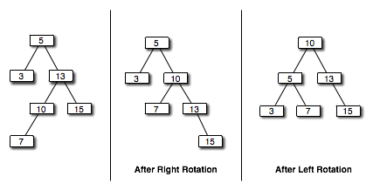
17.3 – Right-Left Rotation
If the imbalance is caused by a long path in the left subtree of the right child of the root we can address it by
  performing a right rotation around the offending subtree
  and then performing a left rotation around the root

Slide 16
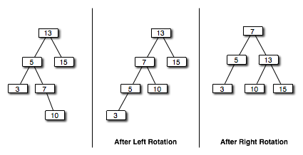
17.3 – Left-Right Rotation
If the imbalance is caused by a long path in the right subtree of the left child of the root we can address it by
  performing a left rotation around the offending subtree
  and then performing a right rotation around the root

Slide 17
Outline
Binary Search Trees (BSTs)
BST Implementation
Balanced Binary Search Trees
Heaps
Heap Implementation
Heap Sort

Slide 18
17.4 – Heaps
A heap is a complete binary tree in which each element is greater than or equal to both of its children
Two binary tree extensions present in a heap
  it is a complete tree
  the constraint on the elements
As with binary search trees, there are many possible heap configurations for a given set of elements
Our definition above is really a maxheap

Slide 19
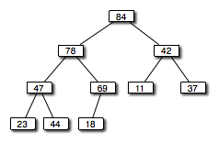
17.4 – An Example Maxheap

Slide 20
17.4 – Heaps
Heap operations work for minheaps
A maxheap keeps the largest value of a set of elements readily available
Three primary operations for maxheaps
  add new element to the heap
  find the maximum value
  remove the maximum value

Slide 21
17.4 – Adding an Element to a Heap
To add an element to the heap, add the element as a leaf, keeping the tree complete
Then, move the element up toward the root, exchanging positions with its parent, until the relationship among the elements is appropriate
This will guarantee that the resulting tree will conform to the heap criteria

Slide 22
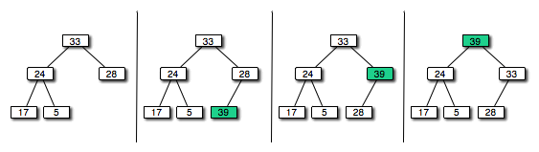
17.4 – Adding an Element to a Heap

Slide 23
17.4 – Removing the Largest Element from a Heap
We know that the largest element in a heap can be found at the root
Thus, we remove the root and reconstruct the heap from the two disjoint subtrees remaining
Move the last leaf of the tree to be the new root of the tree
Then, move it down the tree as needed (compare to the children) until the relationships among the elements is appropriate

Slide 24
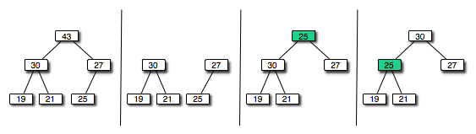
17.4 – Removing the Largest Element from a Heap

Slide 25
Outline
Binary Search Trees (BSTs)
BST Implementation
Balanced Binary Search Trees
Heaps
Heap Implementation
Heap Sort

Slide 26
17.5 – Heap Implementation
Our implementation commits at the interface level whether our collection is a minheap or maxheap
The interface contains methods for
  adding a new element to the help
  obtaining the highest value in the heap
  and removing the highest value in the heap
Because a heap is a binary tree, our implementation can be based on the LinkedBinaryTree class

Slide 27
17.5 – javafoundations.MaxHeap
//*******************************************************************
// MaxHeap.java Java Foundations
//
// Defines the interface to a max heap.
//*******************************************************************
package javafoundations;
public interface MaxHeap<T extends Comparable<T>> extends BinaryTree<T>
{
// Adds the specified object to the heap.
public void add (T obj);
// Returns a reference to the element with the highest value in
// the heap.
public T getMax ();
// Removes and returns the element with the highest value in the
// heap.
public T removeMax ();
}

Slide 28
17.5 – javafoundations.MaxHeap
//*******************************************************************
// LinkedMaxHeap.java Java Foundations
//
// Implements a max heap using a linked representation.
//*******************************************************************
package javafoundations;
import javafoundations.exceptions.*;
public class LinkedMaxHeap<T extends Comparable<T>>
extends LinkedBinaryTree<T> implements MaxHeap<T>
{
private HeapNode<T> last;
//-----------------------------------------------------------------
// Creates a max heap with the specified element as its root.
//-----------------------------------------------------------------
public LinkedMaxHeap ()
{
super();
last = null;
}
(more…)

Slide 29
17.5 – javafoundations.MaxHeap
//-----------------------------------------------------------------
// Creates a max heap with the specified element as its root.
//-----------------------------------------------------------------
public LinkedMaxHeap (T element)
{
root = new HeapNode<T>(element);
last = (HeapNode<T>)root;
}
//-----------------------------------------------------------------
// Adds the specified element to this heap by adding it as a leaf
// then reestablishing the heap relationships.
//-----------------------------------------------------------------
public void add (T element)
{
HeapNode<T> node = new HeapNode<T>(element);
HeapNode<T> newParent = null;
if (root == null)
root = node;
(more…)

Slide 30
17.5 – javafoundations.MaxHeap
else
{
newParent = ((HeapNode<T>)root).getParentAdd(last);
if (newParent.left == null)
newParent.setLeft(node);
else
newParent.setRight(node);
}
node.setParent(newParent);
last = node;
((HeapNode<T>)root).heapifyAdd(last);
}
(more…)

Slide 31
17.5 – javafoundations.MaxHeap
//-----------------------------------------------------------------
// Remove the element with the largest value in this heap and
// returns a reference to it.
//-----------------------------------------------------------------
public T removeMax()
{
if (root == null)
throw new EmptyCollectionException ("Remove max operation " +
"failed. Tree is empty.");
T maxElement = root.getElement();
if (root.count() == 1)
root = last = null;
else
{
HeapNode<T> newLast = ((HeapNode<T>)root).getNewLastNode(last);
if (last.parent.left == last)
last.parent.left = null;
else
last.parent.right = null;
(more…)

Slide 32
17.5 – javafoundations.MaxHeap
root.setElement(last.getElement());
last = newLast;
((HeapNode<T>)root).heapifyRemove((HeapNode<T>)root);
}
return maxElement;
}
//-----------------------------------------------------------------
// The following method is left as a programming project.
//-----------------------------------------------------------------
// public T getMax() { }
}

Slide 33
17.5 – javafoundations.HeapNode
//*******************************************************************
// HeapNode.java Java Foundations
//
// Represents a node, and the root of a subtree, in a heap.
//*******************************************************************
package javafoundations;
public class HeapNode<T extends Comparable<T>> extends BTNode<T>
{
HeapNode<T> parent;
//-----------------------------------------------------------------
// Creates a new heap node with the specified data.
//-----------------------------------------------------------------
public HeapNode (T element)
{
super(element);
parent = null;
}
(more…)

Slide 34
17.5 – javafoundations.HeapNode
//-----------------------------------------------------------------
// Returns the parent node of this node.
//-----------------------------------------------------------------
public HeapNode<T> getParent()
{
return parent;
}
//-----------------------------------------------------------------
// Returns the parent node of this node.
//-----------------------------------------------------------------
public void setParent(HeapNode<T> parent)
{
this.parent = parent;
}
(more…)

Slide 35
17.5 – javafoundations.HeapNode
//-----------------------------------------------------------------
// Returns the node that will be the parent of the new node.
//-----------------------------------------------------------------
public HeapNode<T> getParentAdd (HeapNode<T> last)
{
HeapNode<T> result = last;
while ((result.parent != null) && (result.parent.left != result))
result = result.parent;
if (result.parent != null)
if (result.parent.right == null)
result = result.parent;
else
{
result = (HeapNode<T>) result.parent.right;
while (result.left != null)
result = (HeapNode<T>) result.left;
}
else
while (result.left != null)
result = (HeapNode<T>) result.left;
return result;
}
(more…)

Slide 36
17.5 – javafoundations.HeapNode
//-----------------------------------------------------------------
// Moves a newly added leaft up the tree as far as appopriate to
// reestablish the heap.
//-----------------------------------------------------------------
public void heapifyAdd (HeapNode<T> last)
{
T temp;
HeapNode<T> current = last;
while ((current.parent != null) &&
((current.element).compareTo(current.parent.element) > 0))
{
temp = current.element;
current.element = current.parent.element;
current.parent.element = temp;
current = current.parent;
}
}
(more…)

Slide 37
17.5 – javafoundations.HeapNode
//-----------------------------------------------------------------
// Returns the node that will be the new last node after a remove.
//-----------------------------------------------------------------
public HeapNode<T> getNewLastNode(HeapNode<T> last)
{
HeapNode<T> result = last;
while ((result.parent != null) && (result.parent.left == result))
result = result.parent;
if (result.parent != null)
result = (HeapNode<T>) result.parent.left;
while (result.right != null)
result = (HeapNode<T>) result.right;
return result;
}
(more…)

Slide 38
17.5 – javafoundations.HeapNode
//-----------------------------------------------------------------
// Reorders this heap after removing the root element.
//-----------------------------------------------------------------
public void heapifyRemove(HeapNode<T> root)
{
T temp;
HeapNode<T> current = root;
HeapNode<T> next = largerChild (current);
while (next != null && next.element.compareTo(current.element) > 0)
{
temp = current.element;
current.element = next.element;
next.element = temp;
current = next;
next = largerChild (current);
}
}
(more…)

Slide 39
17.5 – javafoundations.HeapNode
//-----------------------------------------------------------------
// Returns the larger of the two children of the specified node.
//-----------------------------------------------------------------
public HeapNode<T> largerChild (HeapNode<T> node)
{
HeapNode<T> larger = null;
if (node.left == null && node.right == null)
larger = null;
else if (node.left == null)
larger = (HeapNode<T>)node.right;
else if (node.right == null)
larger = (HeapNode<T>)node.left;
else if (((HeapNode<T>)node.left).element.compareTo(
((HeapNode<T>)node.right).element) > 0)
larger = (HeapNode<T>)node.left;
else
larger = (HeapNode<T>)node.right;
return larger;
}
}

Slide 40
17.5 – Implementation Notes
The LinkedMaxHeap class inherits the root reference from the LinkedBinaryTree
It also keeps track of the “last node” in the heap – the last leaf in the complete tree
The HeapNode class inherits the left and right reference variables from the BTNode class
A HeapNode object also keeps a reference to its parent object (node), allowing us to move up the tree path

Slide 41
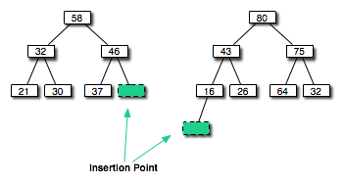
17.5 – Implementation Notes
Consider the process of adding a new element as the “last leaf” in the complete tree
There is only one possible position to add that leaf
However, this position might be on the level of current leaves, or it could be the first position of the next level if the tree is currently full

Slide 42
17.5 – Implementation Notes
The add method of LinkedMaxHeap relies on two support methods
  getParentAdd: gets the parent of the new node to be added.
  Starting at the last node in the tree, considers all posibilities, looking for the node that will serve as the parent of the new node being added.
  It looks up the tree until it is a left child of some node, or it finds the root. If it reaches the root, then the new node is leftmost descendent of the root (and the new leaf begins a new level). If it fails to reach the root, it looks for the leftmost descendent of the right child.
  heapifyAdd: reestablishes the heap after the leaf is added.
  Uses the parent references to move up the tree, swapping elements as needed. Note that it only exchanges the elements, it does not move nodes

Slide 43
Outline
Binary Search Trees (BSTs)
BST Implementation
Balanced Binary Search Trees
Heaps
Heap Implementation
Heap Sort

Slide 44
17.6 – Heap Sort
Given the ordering property of a heap, it is natural to think of using a heap to sort a list of numbers
A heap sort sorts a set of elements by adding each one to a heap, then removing them one at a time
The largest element comes off the heap first, so the sequence will be in descending order
Similarly, a minheap can be used to sort the values in ascending order

Slide 45
Summary
This chapter has focused on
  Introducing binary search trees and their operations
  A binary search tree implementation
  Degenerate trees
  Tree balancing and rotation algorithms
  Heaps and their implementation
  Heap sort

